Slide 1

Telco Customer Churn Analysis
Subtitle : Insights for Better Customer Retention
"Customer churn is more than just a statistic; it's a reflection of customer experience and satisfaction. Reducing churn can lead to increased revenue, lower acquisition costs, and a more stable customer base.
Understanding churn is essential for fostering customer loyalty and driving growth
Today, we'll analyze various factors that contribute to churn and how we can proactively address these issues.“
Let’s dive deeper .

Slide 2
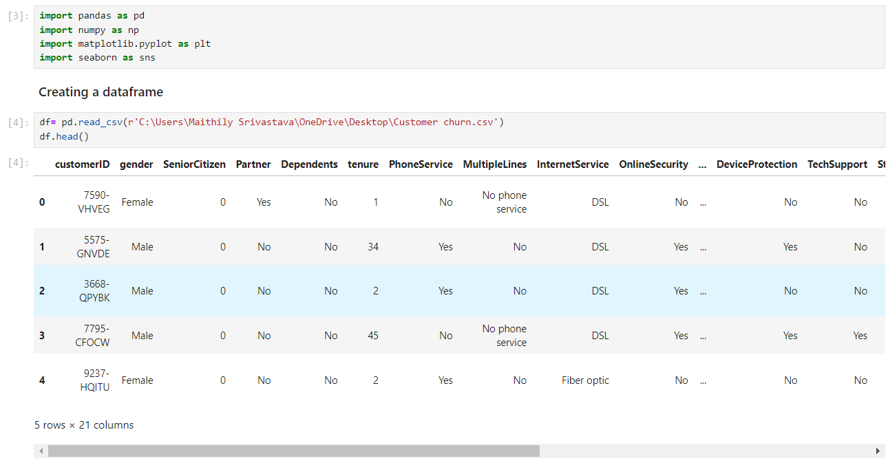
Leveraging Python for Customer Churn Analysis
"Python played a crucial role in customer churn analysis. Its powerful libraries for data manipulation and visualization allowed me to efficiently process and analyze dataset."
Contents used :
Pandas: For data cleaning and manipulation
Matplotlib & Seaborn: For creating insightful visualization

Slide 3
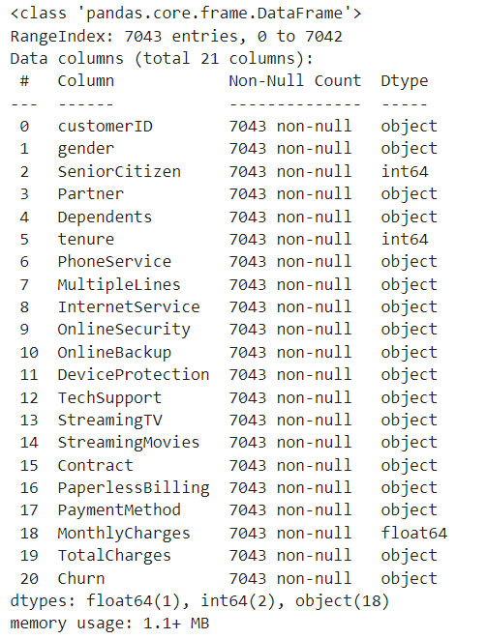
After importing the dataset into Jupyter Notebook let’s understand what all steps I have taken to analyze customer churn .
This code helped to fetch the information about the data and after evaluating it, I have made certain changes in the columns.
Here I will showcase the insights in this presentation.
And also mentioned all the important keys , before that I have added a screen shot of the initial information without any change.
To better understand the changes that I have made in this data we will have a look into Jupyter Notebook itself .
Used the above code to fetch null values if any .
Note: On all the highlighted columns I have made the necessary changes and have represented in python about which I will be discussing on python file only .

Slide 4
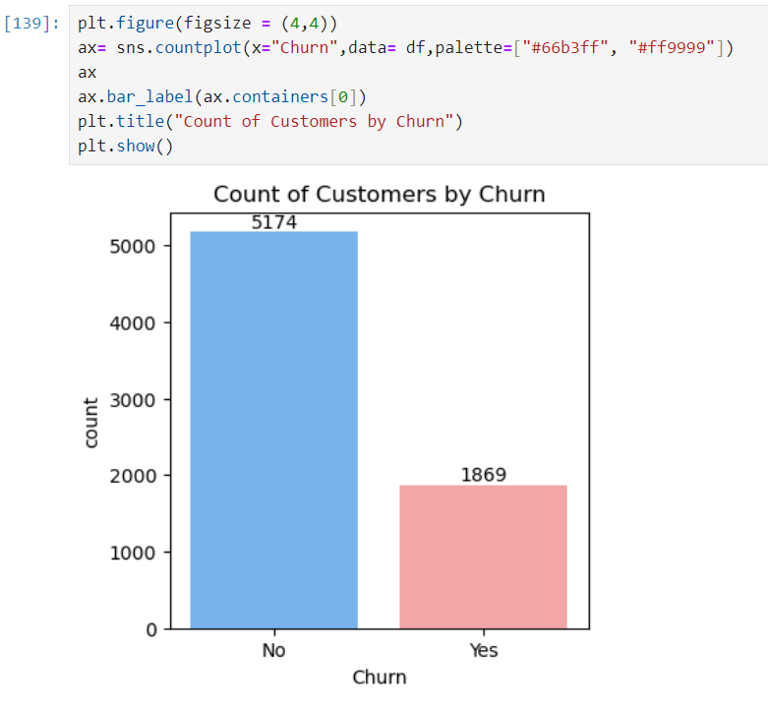
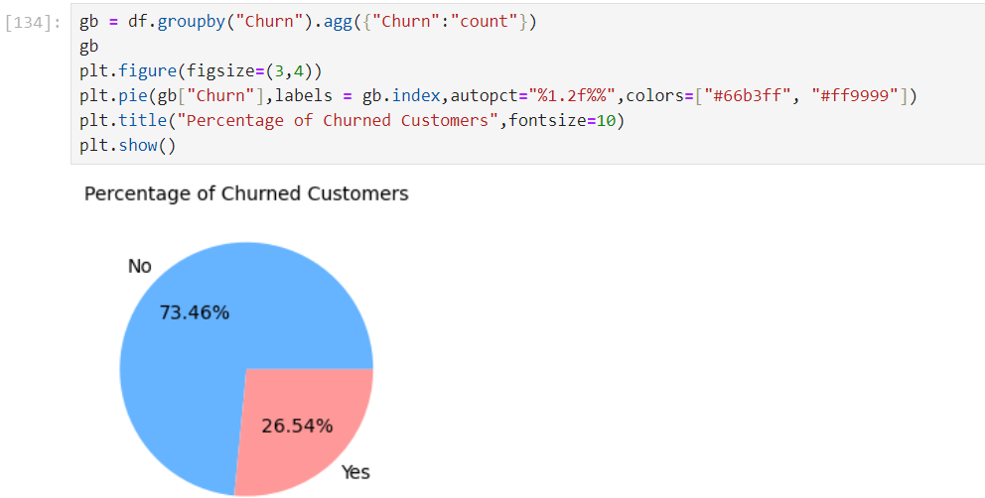
Moving to Analysis part we need that know the how many customers have churned
Representing the count of churned customers followed by a graph, here we can see that 5174 customers have stayed with us and enjoyed our service on the other hand 1869 customers have churned out .
Representing the percentage of churned customers through a pie chart.
We can conclude that percentage wise that overall 26.54% customers
have churned
Now let’s understand the reason behind it .

Slide 5
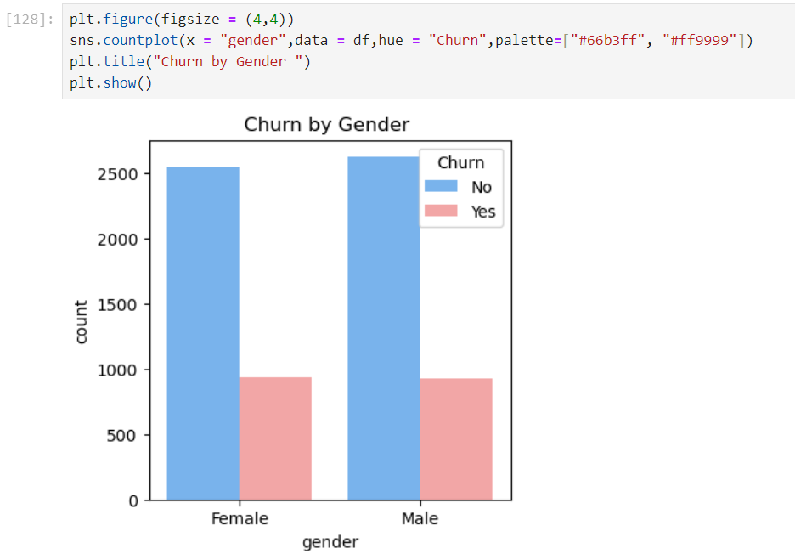
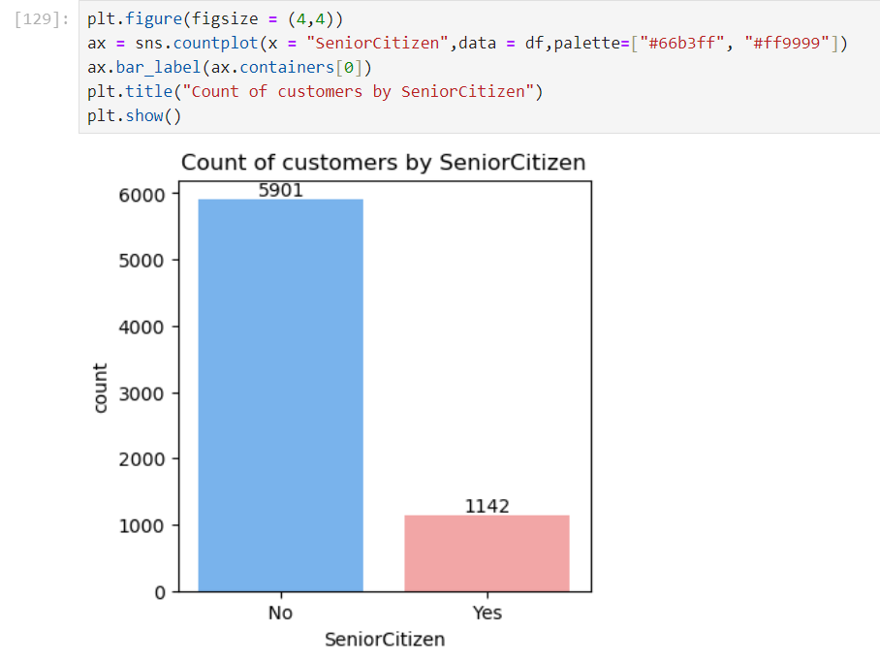
Exploring the data based on Gender
Based on the above analysis we can see that equal amount of customers are churning out and it is not gender specific which means it does not matter if the customer here is male or female .
We must go through the other aspect to understand the dataset more .
Exploring the data based on Senior Citizen
Here we can see that 1142 Senior citizens have churned out which is showing quite a drastic difference .
We need to analyze Senior citizen column a bit more to understand the difference .

Slide 6
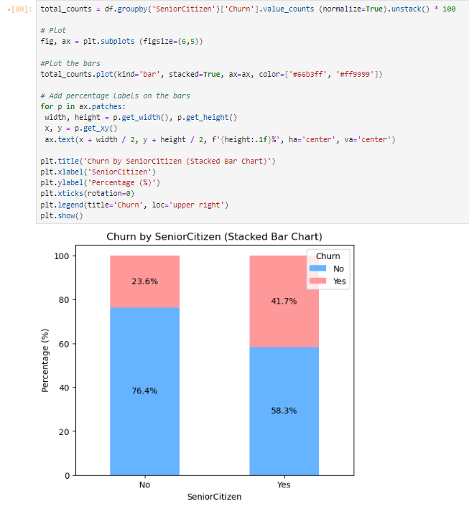
Analyzing dataset based on Senior Citizen using a stacked bar chart
This code calculates the percentage of customers who churned or
didn't churn, grouped by whether they are senior citizens or not. It
then plots this data in a stacked bar chart with two different colors,
adds percentage labels on the bars, and customizes the appearance
of the chart. The chart helps visually analyze how churn rates differ
between senior citizens and non-senior citizens.
This chart represents the percentage of customer churn based on
whether the customer is a Senior Citizen or not. Among non-Senior
Citizens, 23.6% have churned, while the majority, 76.4%, have not.
In contrast, Senior Citizens show a higher churn rate, with 41.7%
churning and 58.3% staying. The chart highlights that Senior Citizens
are more likely to churn compared to non-Senior Citizens.

Slide 7
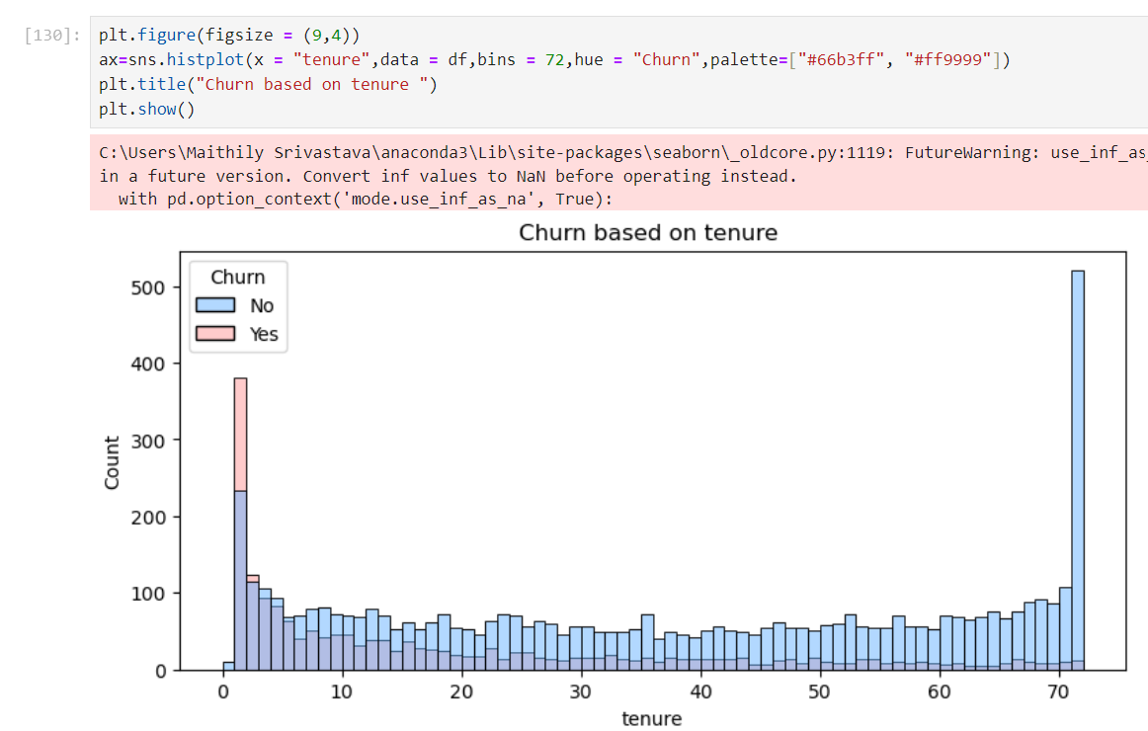
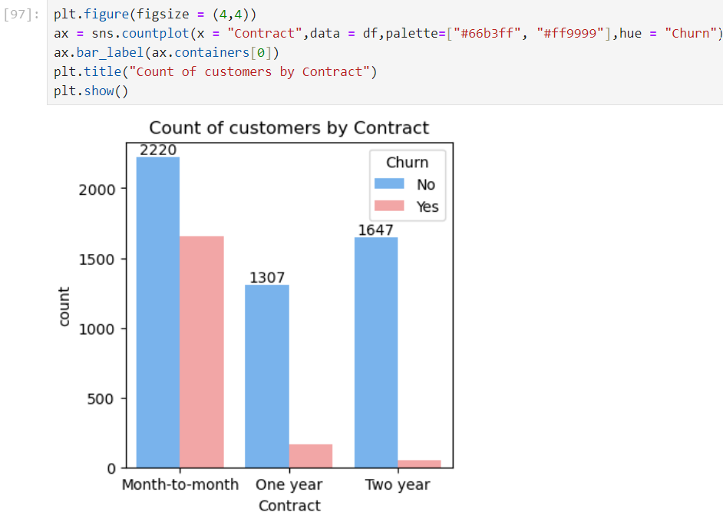
Exploring data based on tenure
We can clearly see that the customers who were with us for 1 or 2 months or let’s say that the customers who used the services for short duration have churned out and the customers who have used the services for a long time have stayed .
This could be because of the type of contract they may be in, based on this information let’s analyze Contract .
Exploring data based on Contract
No doubt the number of customers who used the services on month to month basis are more but still we can see that churn rate here is much higher, and people with long term contract of one or two years have stayed the possible reason could also be due to the service benefits that they may be getting .
We can work on customers using month-to –month service and can convince them by elaborating the benefits of long term service which can possibly lead to low churn rate.

Slide 8
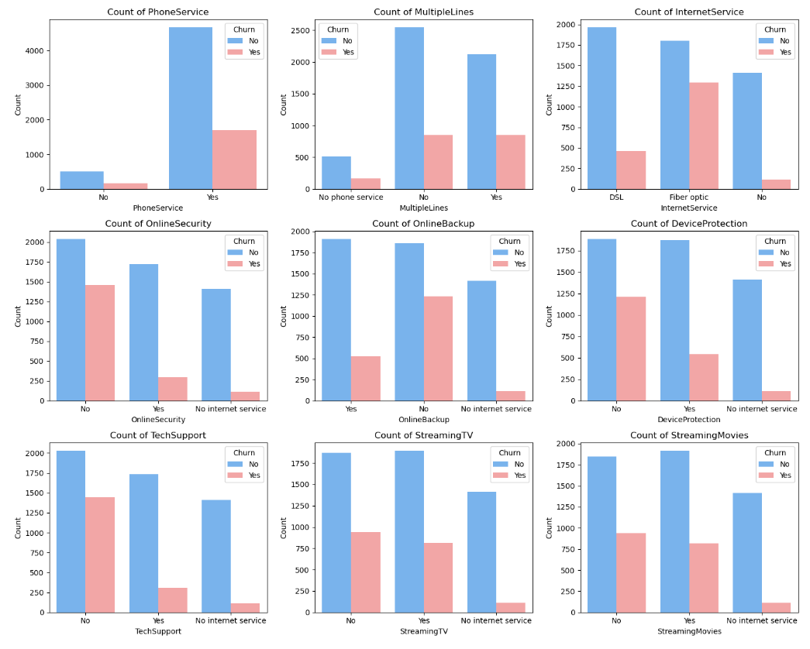
Exploring all the services oriented columns
In this particular section since I could see a lot of
columns were representing services provided to
the customers so I created a subplot which has
helped me in analyzing these columns all together .
We can clearly see the comparison of how people
have Churned .
The majority of customers who do not churn
tend to have services like Phone Service,
Internet Service (particularly DSL), Online
Security and Tech support enabled.
For services like Online Backup , Streaming TV,
Device protection churn rates are noticeably
higher when these services are not used or are
unavailable.
The charts emphasize the relationship
between service usage and customer churn.

Slide 9
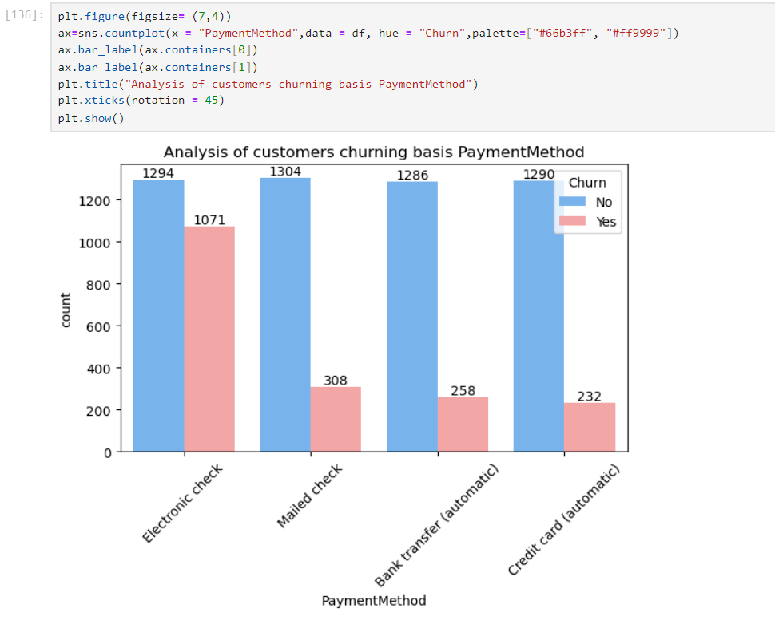
Exploring data based on Payment method
It is observed that for some reason customers using
Electronic check have churned a lot , however the ratio
of customers using mailed check / bank transfer
(automatic )/ credit card (automatic) is very low.
One possible reason for this preference is the
convenience and reliability of automatic payments,
which reduce the chance of missed or late payments.
This ease of use may lead to better customer
satisfaction and retention.
On the other hand, electronic checks, while still popular,
have a higher churn rate. This could be due to the
manual nature of this payment method, which may
require more effort from customers

Slide 10
Executive Summary
Objective:
The analysis explores customer churn patterns, focusing on various factors such as payment methods, contract types, tenure, churn by senior citizen. The goal is to identify which factors are most strongly associated with higher churn rates to guide customer retention strategies.
Key Insights:
Contract Type: Customers on month-to-month contracts show a higher tendency to churn compared to those on yearly or bi-annual contracts. This suggests that long-term contracts may improve customer retention.
Payment Methods: A significant proportion of customers using electronic checks are more likely to churn compared to those using other payment methods (credit cards, bank transfers, etc.). This could be due to convenience or trust issues associated with electronic check payments.
Churn Rate by Tenure : Customers with shorter tenure (less than one year) are more likely to churn, indicating the criticality of initial engagement strategies.
Senior Citizens and Churn: The analysis reveals that senior citizens have a churn rate of 41%, compared to a 23.6 % churn rate among non-senior citizens.
Visualizations : The visualizations, including bar plots , highlight the disparity in churn rates by different contract types and payment methods. They also show trends over customer tenure, supporting the need for personalized retention strategies.
Recommendations:
• Promote Long-Term Contracts : Offer incentives for customers to commit to longer contracts to reduce churn.
• Address Payment Method Concerns: Implement campaigns encouraging customers to switch from electronic checks to more reliable payment methods.
• Customer Engagement in Early Tenure : Focus on improving the customer experience within the first year, as churn is highest in this period.
• Special Senior Citizen Retention Programs : Create personalized offers or assistance programs to retain the senior demographic.

